Slide 1
The Military Rule of 1958 and The Basic Democracy of Ayub Khan

Slide 2
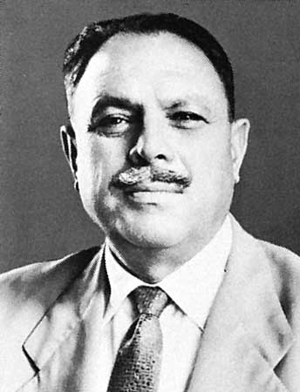
Guess! Who is he?

Slide 3
Why Military Took over the Power?
The Intentional barrier on the development of democracy and democratic institutions:
Power Party’s conflict with United Front
UF Government was dissolved on 30 May, 1954 (92-A of India act 1935)
Sher-e-Bangla and UF Govt. was accused with quisling and Adamjee jute mill incident
As a result, bad example was placed upon the elite military and bureaucrates which ultimately displeased the political leaders and created political chaos (Keios) in both wing

Slide 4
Why Military Took over the Power? (Con.)
2. Internal Conflict among UF
On the formation of Cabinet (237 Seats-AL got 143 Seats but no representation..)
In the long run military took the full advantage of this instability
3. 1956 Scarcity of Food and the Failure of Government
Food Scarcity and incapability of govt. to import food and supplies
Peoples ‘Bhukha’ procession and killings.
4. Internal Conflict in Awami League and the Fall of Awami Government
United Front dissolved
New Govt. formed by Ataur Rahman and his enmity with Sheikh Mujibur Rahman ( In 1958, 31st March govt. disolved)
5. Killing of Deputy Speaker

Slide 5
Why Military Took over the Power? (Con.)
6. The Undemocratic Decision of Iskander Mirza
Military rule was introduced on 7th Oct, 1958 by Iskander Mirza on the following grounds
Instable Governments
Political Instability
Slowth Economy
Ineffectivity of the Constitution
Misgovernance and public corruption
Who is responsible? Basically he was partly forced by the military and civil bureaucrats and Panjabi business elites

Slide 6
Why Military Took over the Power? (Con.)
7. Ayub’s Aspirations for the Power
Having a comfortable image upon the Army
Was held the post of a minister earlier when he was the chief of staff
So he had taken the command immediate after the proclamation of military rule by Iskander Mirza
10 Years of Military and Semi-Military rule started
8. Threat of losing presidential election in 1958 by President Mirza
9. Dismissals of Prime Ministers C.M. Ali, H.S. Suhrawardy, I.I. Chundrigar in 1956–58
10. Suspensioning of the writ of the Constitution and dissolution of Parliament

Slide 7
Proclamation of Military Rule
On October 7, President Mirza declared martial law in Pakistan.
He abrogated the constitution of 1956, describing it as "unworkable" and full of "dangerous compromises.“
He appointed General Ayub Khan, the Commander-in-Chief of the Pakistani army as the Chief Martial Law Administrator and
Nominated him to become the new Prime Minister of Pakistan, charged with administering the country.

Slide 8
Methods
Curfew
Media Blackout
Mass-Media Manipulation
Propaganda against Elected Politicians
Mass Incarceration of Political Workers
Suspension of fundamental rights such as right to assembly and expression

Slide 9
Flowing Measures were taken with the declaration
b. untill the alternative solution, Martial Law will be in force
a. dismissed the government of Sir Feroz Khan Noon and abrogated the constitution of 1956
d. dissolved the National Assembly of Pakistan and the provincial legislatures.
c. also proceeded to outlaw all political parties

Slide 10
Deposing of Mirza
On October 27, Iskander Mirza resigned from the presidency, transferring it to Ayub Khan.
Both men saw the other as a rival to their respective positions. Mirza believed his own position had become largely redundant after Ayub Khan assumed most executive powers as chief martial law administrator and prime minister, and acted to assert himself, while Ayub Khan thought Mirza was conspiring against him.
It is widely held that Ayub Khan and generals loyal to him forced Mirza to resign.
Mirza was later taken to Quetta, the capital of the province of Baluchistan, before being exiled on November 27 to London, England, where he resided until his death in 1969.

Slide 11
Consolidation
Ayub Khan combined the offices of president and prime minister, becoming both the head of state and government.
He created a cabinet of technocrats, diplomats and military officers.
These included Air Marshal Asghar Khan and Zulfikar Ali Bhutto, the future prime minister.
In contrast with future Pakistani military rulers such as Gen. Zia-ul-Haq and Gen. Pervez Musharraf, Ayub Khan did not seek to hold the posts of president and army chief simultaneously.
He appointed Gen. Muhammad Musa as the new commander-in-chief.
Ayub Khan also obtained judicial validation of his move when the Supreme Court of Pakistan validated and legalised his take-over under the "Doctrine of necessity."

Slide 12
The Basic Democracy of Ayub Khan

Slide 13
Aims and Objectives
To Make People Self-Reliant
Incumbent Measure
Religious Perspective
The Failure of Parliamentary Form of Government
The Failure of the Political Parties
Amalgamation of Civil and Military Administration
For Strengthening his Position
Polarization of Leadership

Slide 14
Basic Democracy
Basic Democracies a local government system introduced during the Ayub regime in the early 1960s. General ayub khan, President of Pakistan, introduced the concept of basic democracy under the Basic Democracies Order, 1959 having made an attempt to initiate a grass-root level democratic system.
The system of Basic Democracies was initially a five-tier arrangement. They were: (i) union councils (rural areas), town and union committees (urban areas); (ii) thana councils (East Pakistan), tehsil councils (West Pakistan); (iii) district councils; (iv) divisional councils; (v) provincial development advisory council.

Slide 15
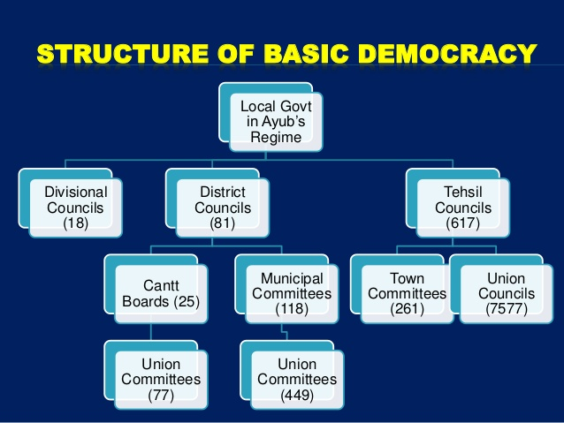
Tier

Slide 16
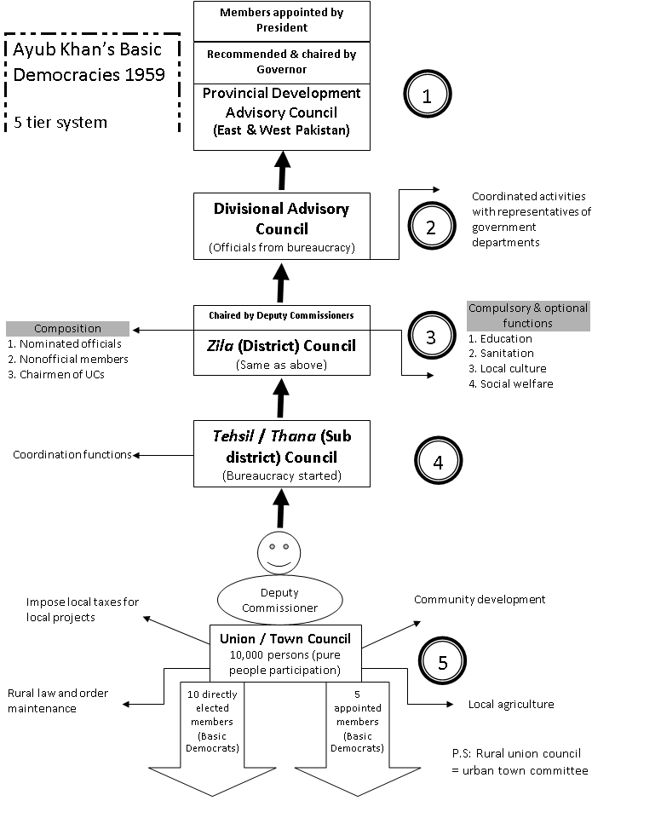

Slide 17
Union Council
At the base of the system was the union council which consisted of a chairman and usually about 15 members. It had both elected and nominated members. Two-thirds of the members were elected representatives and one-third consisted of non-official members nominated by the government. However, the nomination was abolished by an amendment in 1962. The members of the council were elected by the people from their respective unions on the basis of universal adult franchise. The chairman of the council was elected by the members from amongst themselves. The elected representatives of the union council were called basic democrats. The total number of such councils was 7300.

Slide 18
Thana/Tehsil Council
In the second tier was the thana council which consisted of ex-officio representative members, official and non-official members. The representative members were the chairmen of the union councils and town committees. The official members were the representatives of various nation-building departments of a thana and their number was fixed by the district magistrate of the concerned district. The total number of official members could not in any case exceed the number of non-official members. The council was headed by the Sub-Divisional Officer (SDO) who was the ex-officio chairman. In case of West Pakistan, the thana was known as tehsil and it was presided over by a tehsilder. In all, there were 655 thanas and tehsils in Pakistan.

Slide 19
District Council
The third tier was the district council. It consisted of one chairman, official and non-official members. The number of members would not exceed 40. The chairmen of thana councils were its members, and other official members were drawn from district level officers of development departments and an equal number of non-official members. At least 50% the non-official members was drawn from amongst the chairmen of union councils and town committees. The district magistrate acted as chairman of the council while the vice-chairman was elected by the elected members of the council.
. There were 74 district councils in Pakistan. The district council was the most important tier in the basic democracy system. It was the successor organisation to the district board. So far as the composition of the council was concerned, it regressed beyond its 1885 position when 25% members were nominated.

Slide 20
Divisional Council
The fourth and the apex tier was the divisional council. The Divisional Commissioner was the ex-officio chairman of the council. It had both official and non-official (representative) members. The maximum number of members was 45. Official members consisted of the chairmen of district councils of the concerned division and representatives of development departments. The total number of divisional councils was sixteen.

Slide 21
Electoral College
40000 Units from each wing
1 unit =1270 Voters (East Pakistan), 1 unit=1072 Voters (West Pakistan)
1 member for 1 unit and they are called basic democracy member (BD Member)
People can only have the authority to elect BD member
They (BD Member) as electoral college are in charge to elect President, member of national assembly and provincial assembly

Slide 22
Responsibilities and Duties of Basic Democracy Member
1. To caste vote for President, Member of Provincial and National Assembly
2. To supervise the local works program
3. To facilitate the taxation process imposed by local and central government and to maintain the law and order situation and to help the government for the implementation of various projects

Slide 23
The election of BD Members and Number of Elections Held Under Basic Democracy
In jan 1960, with a general election around 80000 BD members were elected from the both wing
1. The Yes/No Vote of 1960-
1960, 14 feb
No contestant except Ayub Khan
Only Two Boxes-Yes or No
75283 (95.6%)
Ayub Khan elected as the President for 5 years term and take oath on 17 feb

Slide 24
2. The Central and Provincial Election of 1962
1962, 28th April- National Assembly
1962, 6th May- Provincial Assembly
Awami League and Nap boycotted and Only ML participated
3. The President Election of 1965
COP-Fatema Jinnah
Ayub Khan get elected

Slide 25
Decisions taken by BD
1. PODO and EBDO
877 politicians-Shaheed Suhrawardy, Khan Abdul Gaffer Khan
2. Imprisonment and Harassment
3. 1962 Constitution and Autocracy

Slide 26
Output of Basic Democracy

